Slide 1
Closing the Health Gap in Brazil:
Data-led Infrastructure Expansion
Overall TBD: Formatting, Notes
Shreya Chaturvedi Kwang Jun Lee Luisa Leite
Bharath Ram Masato Takahashi Carlos Viquez
December 2022

Slide 2
Executive Summary
TBD

Slide 3
Introduction
TBD

Slide 4
Goal: Reduce the unequal access to medical facilities and doctors among municipalities
Devise a strategy to expand the physical and human healthcare infrastructure in Brazil by
Assess the current situation of the healthcare system
Design a machine learning algorithm that will allow us to rank municipalities based on their current disease burden
Compare the demand for medical services at each municipality with the actual provision of healthcare infrastructure

Slide 5
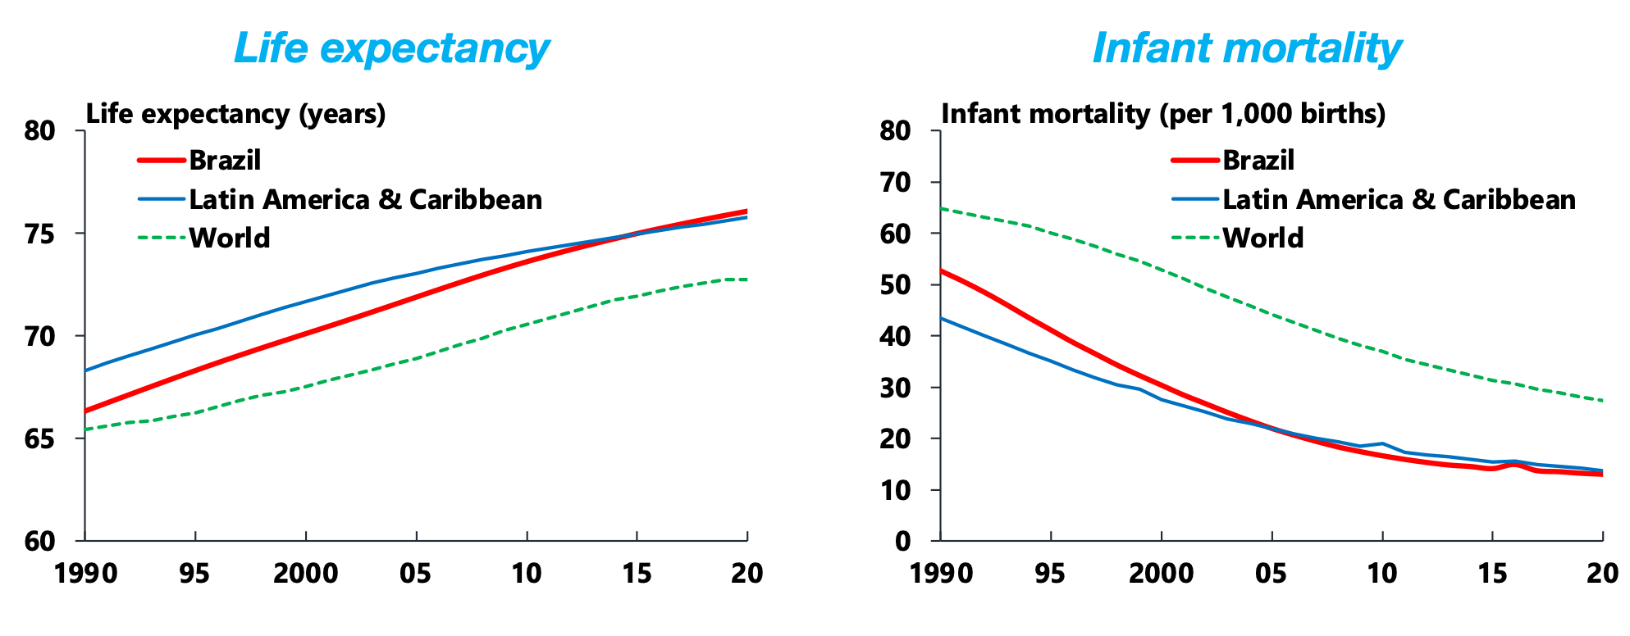
Current Scenario
Life Expectancy
Infant Mortality

Slide 6
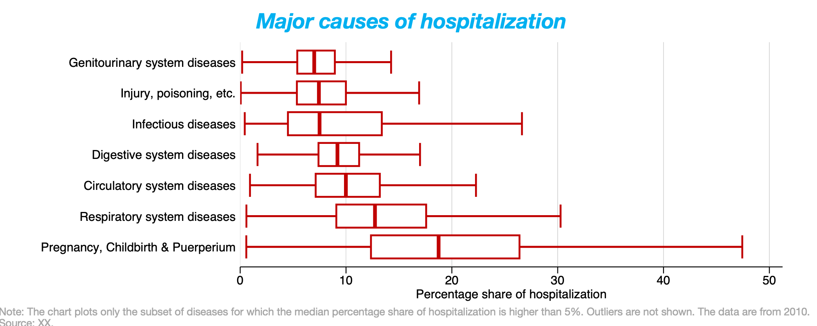
Current Scenario
Cause of Hospitalization Within Municipalities

Slide 7
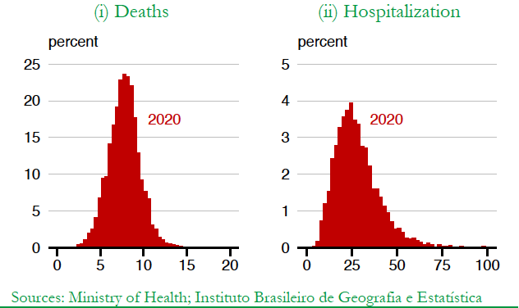
Current Scenario
Distribution Within Municipalities

Slide 8
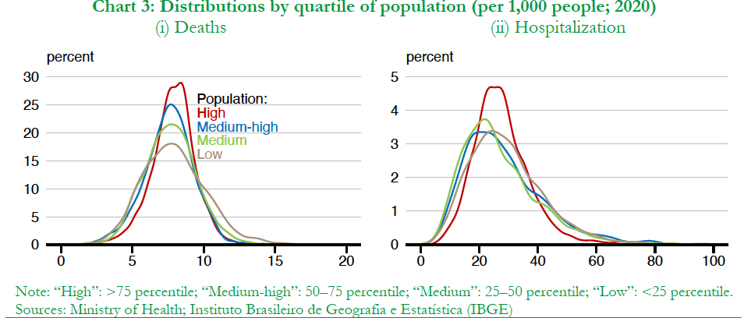
Population Analysis: Deaths and Hospitalization

Slide 9
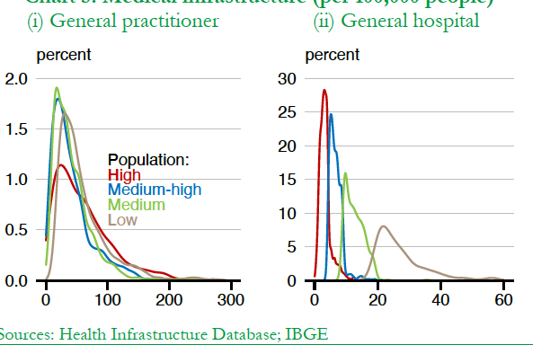
Population Analysis: Health Care Access
No clear relationship
between the size of the
population and the medical
Infrastructure
Thus, our solution needs to be more than just expanding medical
infrastructure in areas with
population.

Slide 10
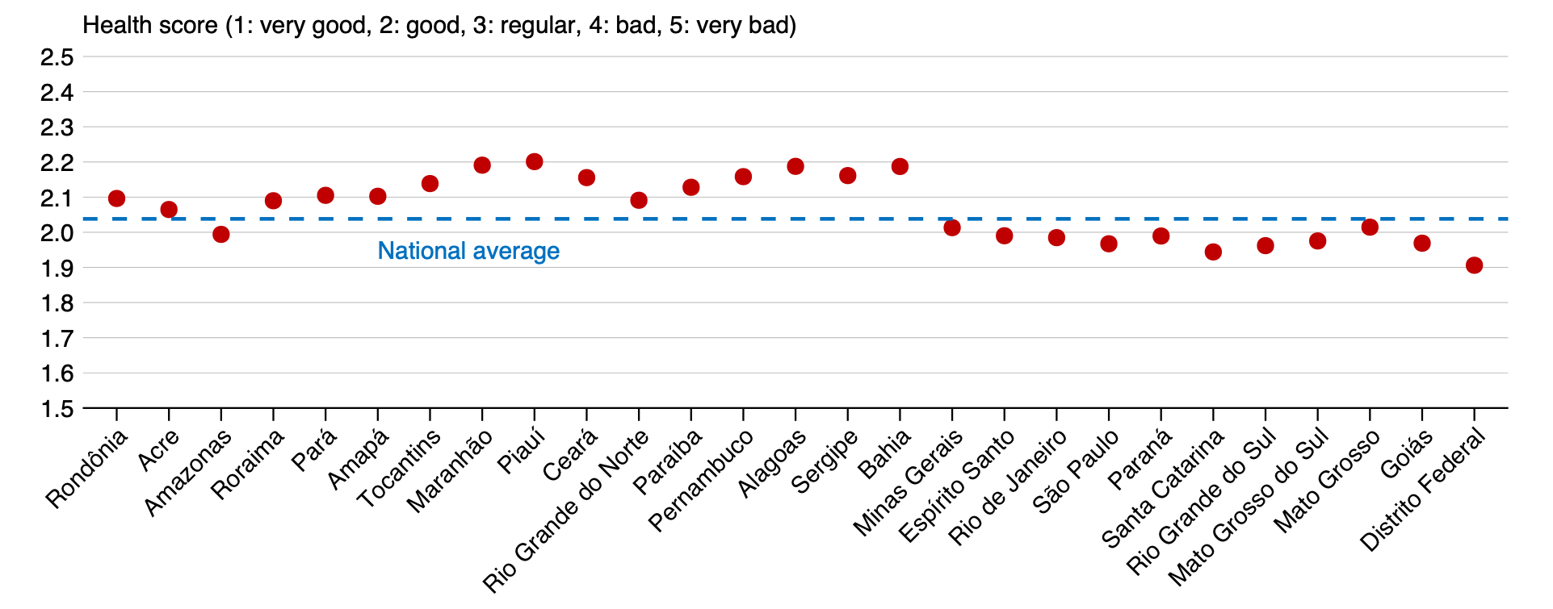
Subjective health conditions for municipalities
State of health (measured on a 1-5 scale) varies greatly across states

Slide 11
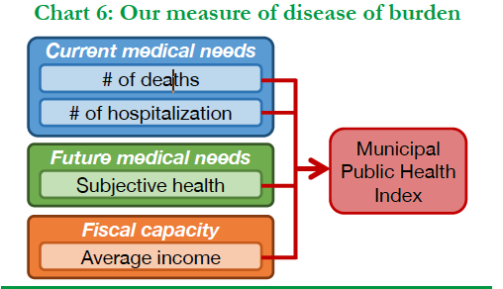
Defining Burden of Disease: MPHI
We recognize the burden of disease to be determined by current and future medical needs
as well as fiscal capacity. We think this way because our ultimate goal is to link the burden of
disease with the necessary investment decision, which must be made in a forward-looking way.
Every investment decision, however, has to be financed in one way or the other. In this regard, it
is also important to take fiscal capacity into account.

Slide 12
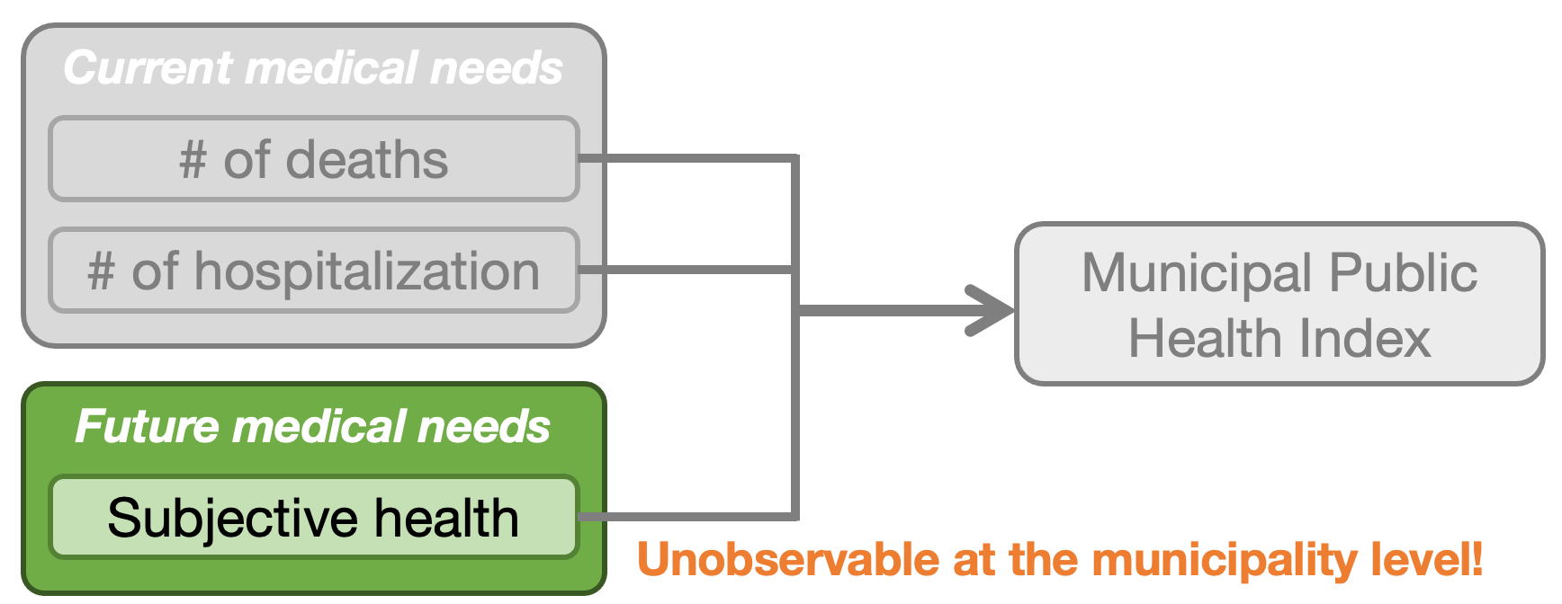
Challenge:
Notes:
Develop a single indicator that captures current healthcare outcomes at the municipality level (i.e. number of deaths and number of hospitalizations) and future medical needs (i.e. subjective health conditions) to help policy makers identify the burden of disease.

Slide 13
Predicting subjective health conditions for municipalities
STEP 1:
Aggregate Census Data
STEP 2:
Regress PNS Score on Census Data
STEP 3:
Predict health score based on the relationship at the state level

Slide 14
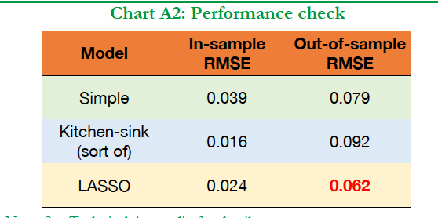
Regress PNS Score on Census Data: 3 Approaches
Simple model: We use the arbitrarily chosen following four variables as independent variables: room density, sewage, water, average age.
Kitchen-sink model: We decide to include the following 14 variables on the right-hand side of the regression equation: room density (almost all potential independent variables)
LASSO model: The third model is a regression-based machine learning model, and appropriate independent variables will be automatically chosen from the pool of 21 potential independent variables.

Slide 15
The MPHI
STEP 1:
Standardize all four indicators: deaths per capita; hospitalizations per capita; the subjective health conditions; and average income (inverted)
STEP 2:
Aggregate the three
(standardized) indicators by taking a simple average.

Slide 16
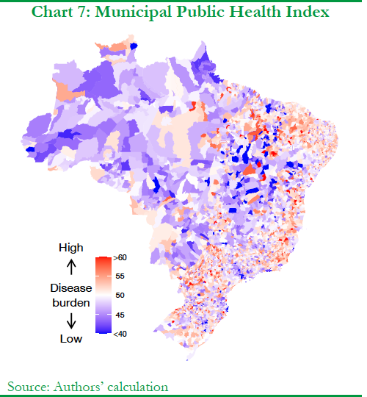
The MPHI
The burden of disease is identified to be higher in municipalities that are located in the north-east region or in the coastal region.

Slide 17
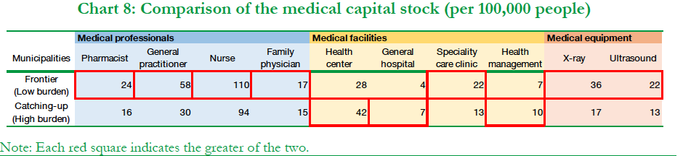
Current State of Health Infrastructure
“Frontier Municipalities”:
groups of municipalities with low burden of disease
MPHI lower than the 25th percentile
More Health Professionals, More Medical Equipment, Fewer Hospitals
“Catch-up Municipalities”:
groups of municipalities with high burden of disease
MPHI lower than the 75th percentile
Fewer Health Professionals, Lower Medical Equipment, More Hospitals

Slide 18
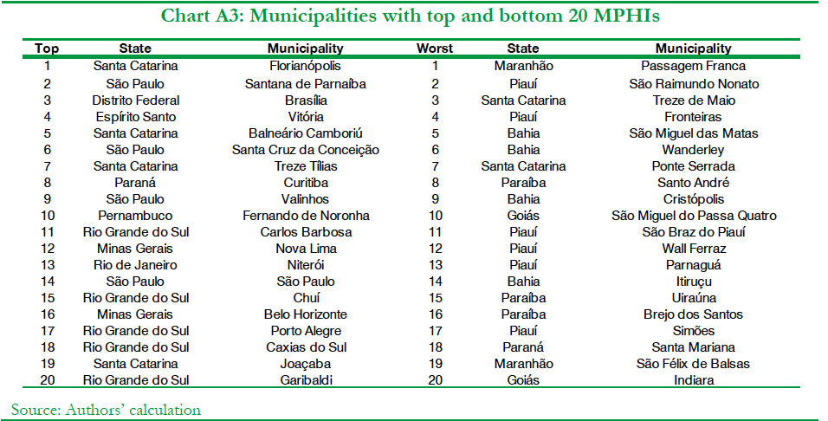
Recommendations: Expanding Healthcare Infrastructure
Increase the number of medical workers and the amount of medical equipment in municipalities with high burden of disease as identified by our MPHI

Slide 19
Risks and Limitations
Major causes of deaths or hospitalizations vary a lot among municipalities. This might imply that municipalities have different medical needs, and such needs are better met with a tailormade strategy for health infrastructure expansion.
Worth considering whether expanding infrastructure in each municipality will be effective, or it is more cost effective if the government makes a major investment in regional hubs across the country. While the availability of data does not allow us to do a deep dive into developing an investment plan that incorporates this aspect, i.e., the accessibility to other municipalities which heavily depends on whether a municipality is in an urban or rural area, we think this is an interesting avenue for future analysis.

Slide 20
Conclusion and Next Steps
TBD
What we have done so far: A Recap
Other information that needs to be collected/analyzed to repeat this analysis in the future

